Slide 1
Building Supply Chains That Don't Exist Yet!
Green Hydrogen Supply Chains
Dr Nahid Yazdani

Slide 2
Learning Objectives
Strengthen the ability to compare and critically evaluate alternative supply chain designs.
Develop the skills to make strategic and operational decisions under conditions of uncertainty.
Gain a robust understanding of net-zero initiatives, decarbonisation drivers, and sustainability imperatives shaping modern supply chains.

Slide 3

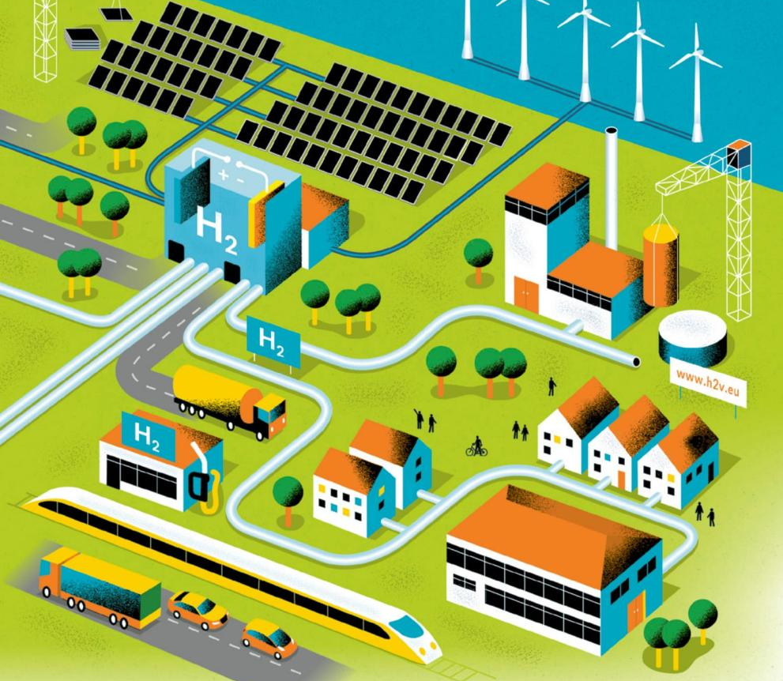
Real Projects Shaping my Interest in Emerging Supply Chains
East Midlands Airport Decarbonisation
Coast to Coat Hydrogen Vally Development

Slide 4
Motivation Decarbonising passenger and freight transport remains a key priority
80%
Net- Zero
In 2008 the UK committed to GHG reduction by 2050 relative to 1990 levels
In 2019 mandated to bring all GHG to net-zero by 2050
Total published emissions arising from UK transport will increase sharply as the UK has committed to include its share of international aviation emissions in its 6th carbon budget (2033-2037).
28%
GHG is related to the UK transport

Slide 5
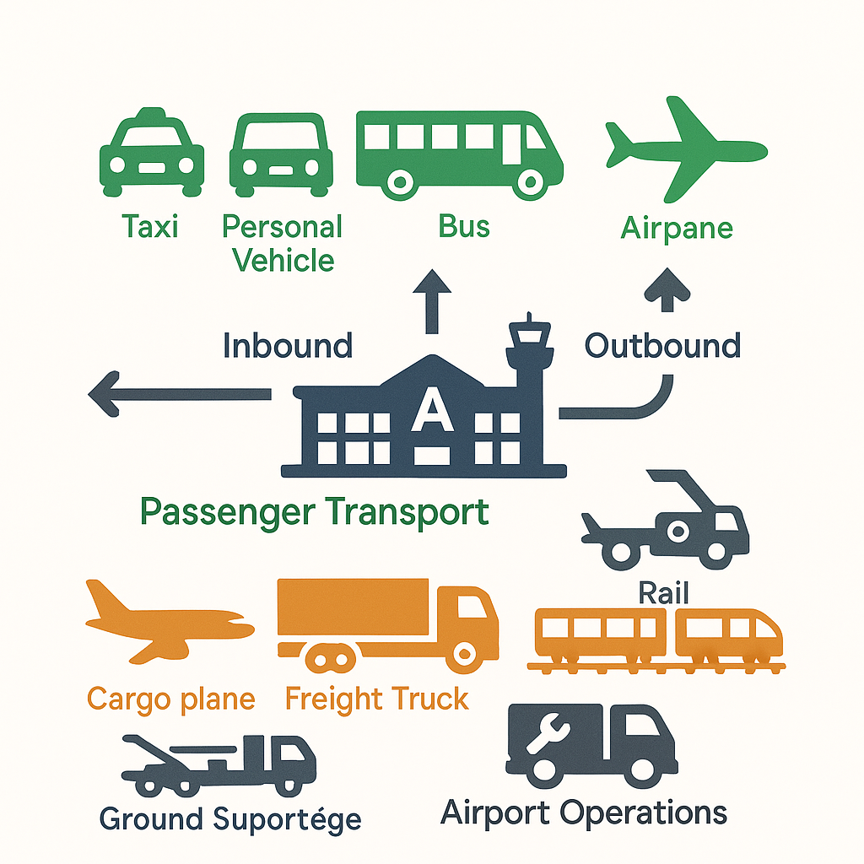
Context
EMA is the UK's busiest 'pure cargo airport' and second only to LHR for total cargo handled
Major global hub for DHL, UPS, FedEx, and Royal Mail
Key economic hub, supporting 6000+ jobs and £300m for the region
The current approach to decarbonising transport is fragmented, focusing on individual technical solutions!
Focusing on this airport ecosystem is ideal as it is small enough to be studied in detail and, at the same time, has sufficiently diverse transport modes (air, road and rail at/around the airport) to shed essential insights on a wide range of energy and infrastructure issues on the way to achieving 2050 net-zero targets!

Slide 6
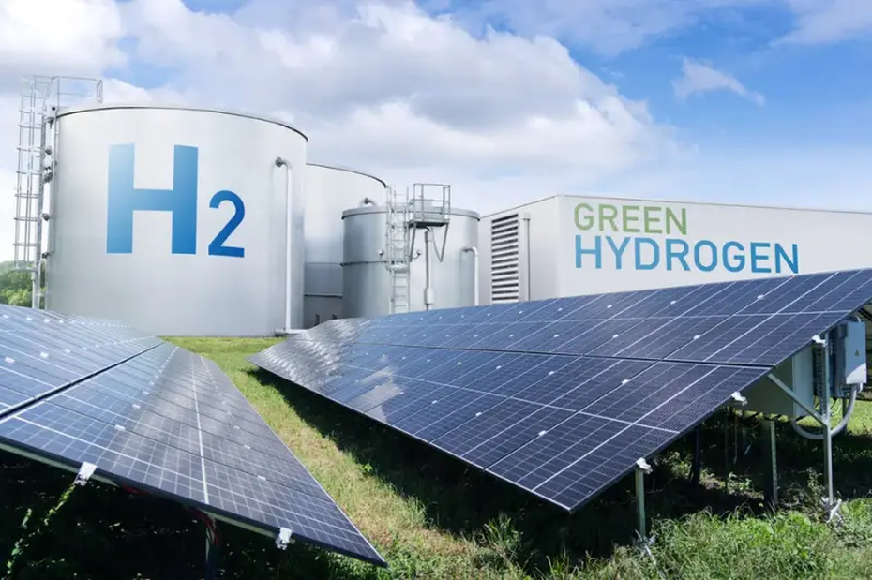
Hydrogen Vally Development
Hydrogen Valley aims to build an end-to-end hydrogen supply chain across regions from renewable hydrogen production to distribution, storage and end use.
The project will establish a cross-regional hydrogen corridor with shared storage sites, transport links and multiple refuelling hubs to ensure reliable, scalable distribution.
Beyond physical assets, the proposal emphasises supply-chain ecosystem development:
supporting SMEs, enabling technology adoption, building skills, engaging communities and shaping policy to create a stable, long-term market for hydrogen.

Slide 7
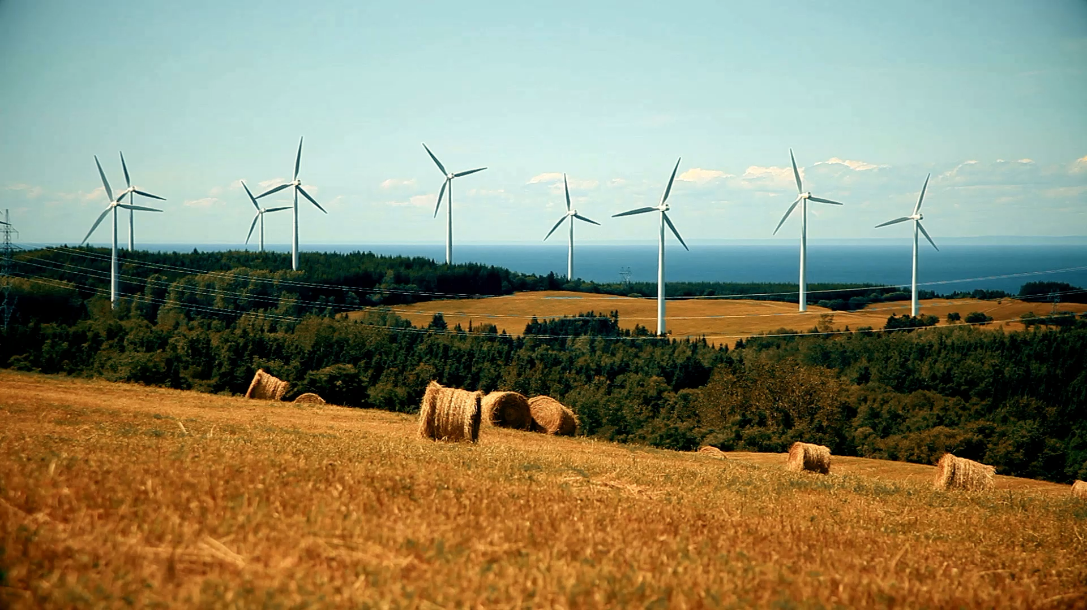
Green Hydrogen = Renewable Electricity Stored as a Gas/Liquid
⚡ → 💧 → H₂

Slide 8
Where hydrogen fits in the energy system
HARD TO DECARBONISE (need hydrogen as fuel or molecules)
These sectors cannot run on batteries because of weight, energy density, or chemical needs:
❌ Long-haul trucks (range + weight constraints)
❌ Shipping (replacement for bunker fuel)
❌ Aviation (very high energy density required)
❌ Steel (needs hydrogen as a chemical reductant)
❌ High-temperature heat (>1000°C)
→ These sectors need hydrogen or hydrogen-derived fuels.

Slide 9
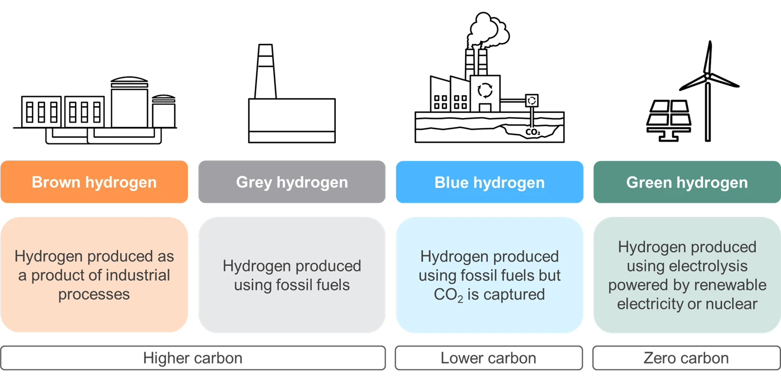
Hydrogen isn't New, But Green Hydrogen is
95 million tons of hydrogen is produced annually today, but 95% is grey.
The challenge is the green premium.

Slide 10
Why Now? Three Forces Creating Momentum
TECHNOLOGY COST CURVES
Electrolyser costs ↓ 60% (2015-2023)
Rapid improvements in hydrogen technology
CLIMATE COMMITMENTS
140+ countries with net-zero targets
Policy momentum forcing earlier action
HARD-TO-ABATE SECTORS
Steel, shipping, aviation, chemicals
No viable alternatives to hydrogen
Sources: UNFCCC 2024; IEA 2023; IRENA 2023

Slide 11



Three Questions that Define the Challenge
How do you make it green?
Production method determines carbon footprint → This is about SOURCE
How do you move it?
Transport costs can exceed production costs → This is about SUPPLY CHAIN
How do you make it affordable?
3-5× cost gap vs. fossil alternatives → This is about SCALE + POLICY

Slide 12
WHAT IS GREEN HYDROGEN SUPPLY CHAIN?

Slide 13
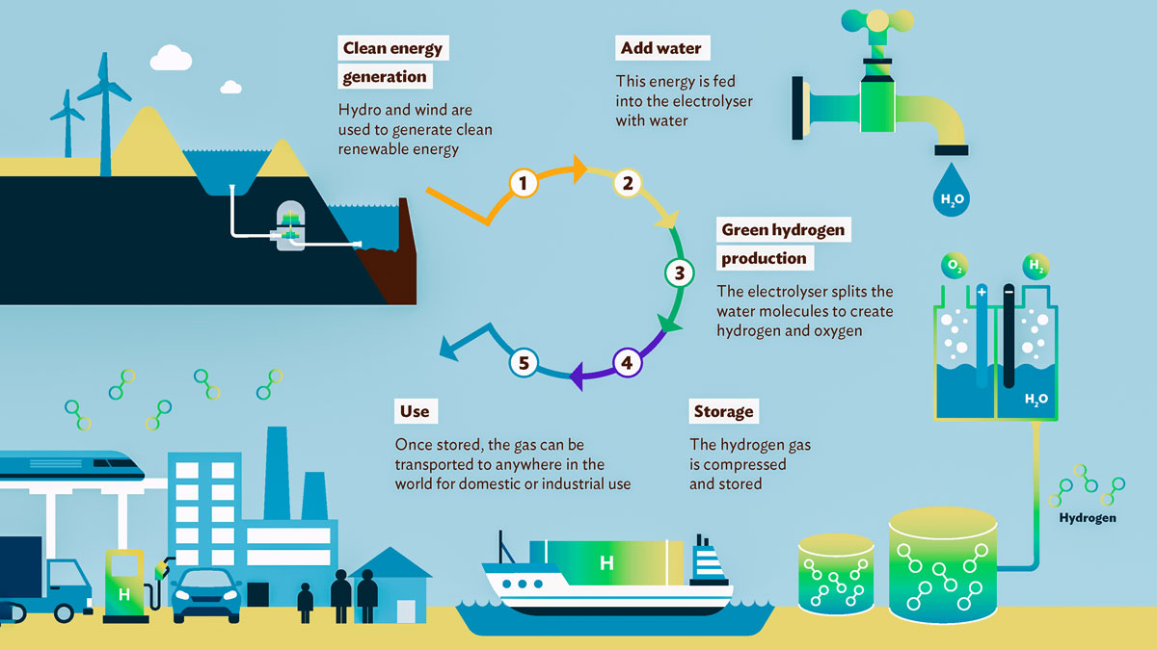
Simplified Green Hydrogen Supply Chain

Slide 14
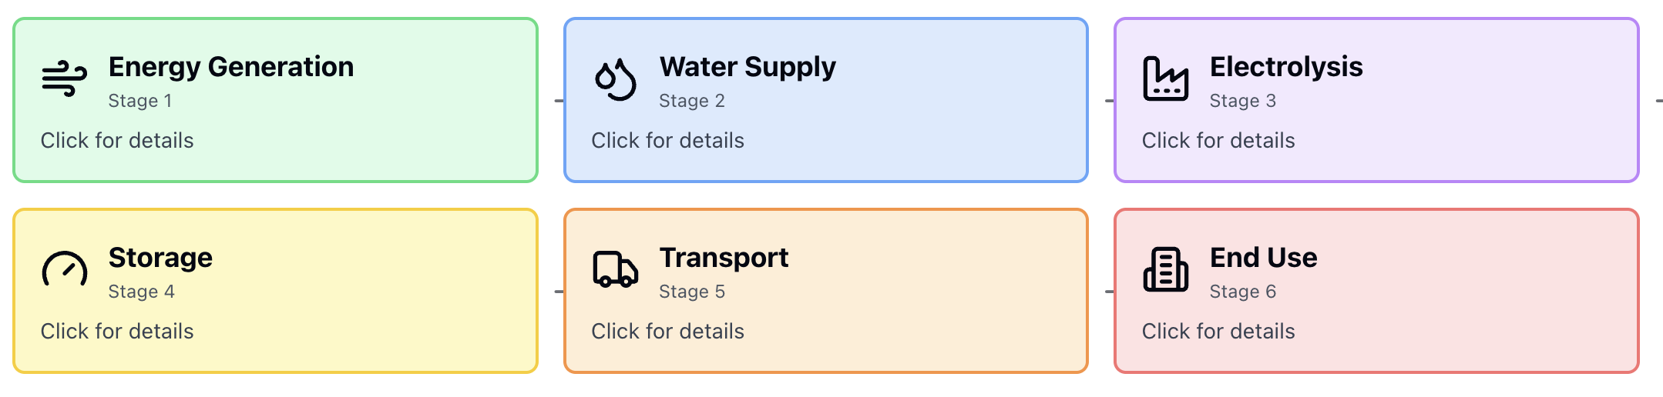
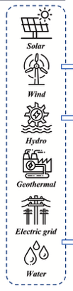
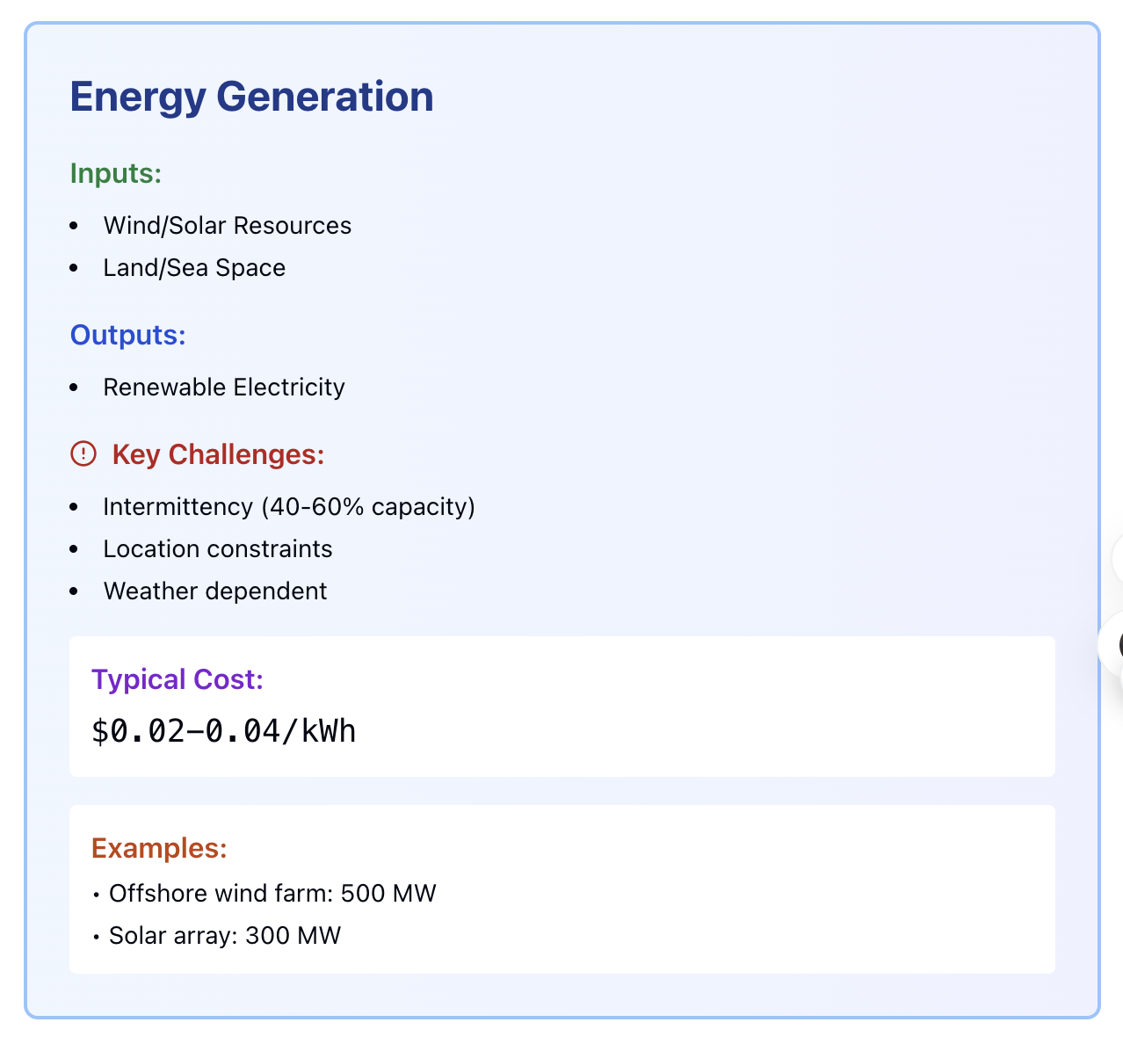
So, do you:
A. Build oversized renewable capacity (expensive but reliable)?
B. Add battery storage (adds cost + losses)?
C. Accept low utilisation (cheap energy but expensive capital)?
D. Use grid backup (cheaper but not "green")?
💡 This first decision cascades through entire supply chain economics

Slide 15
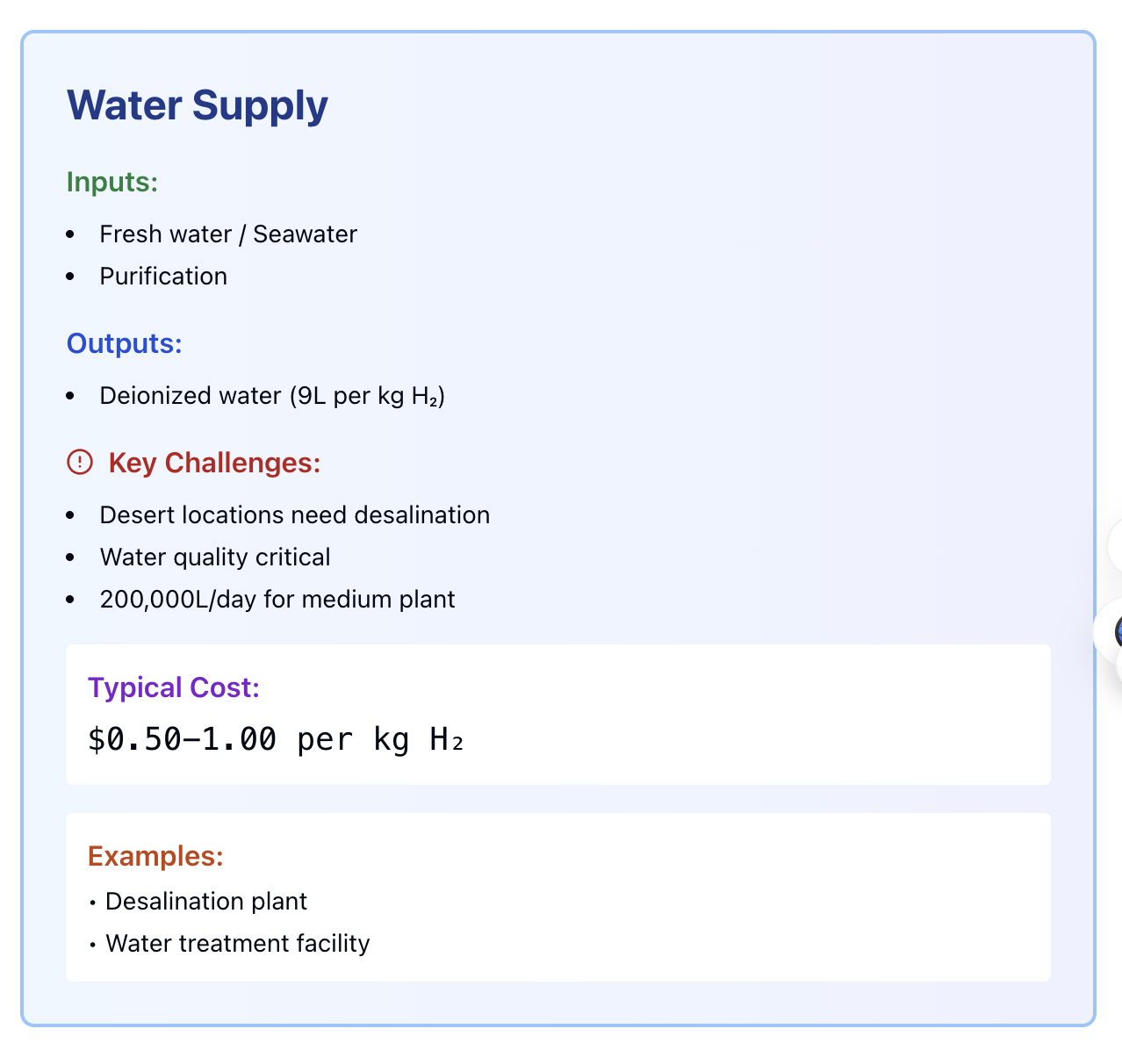

Slide 16
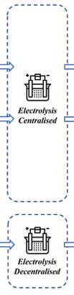
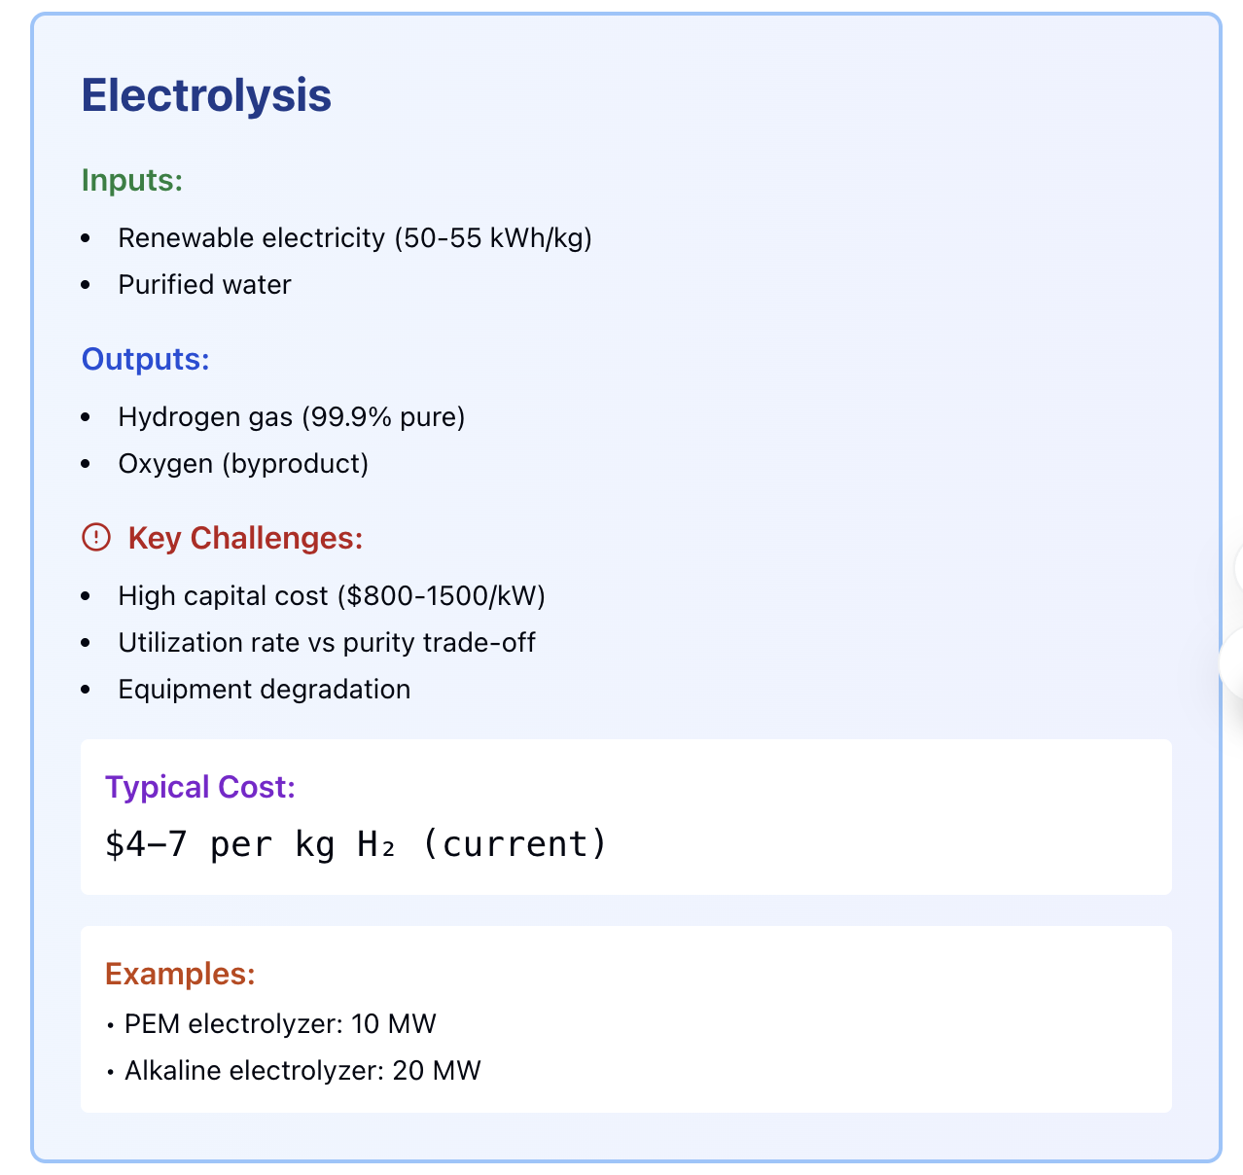

Slide 17
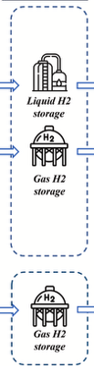
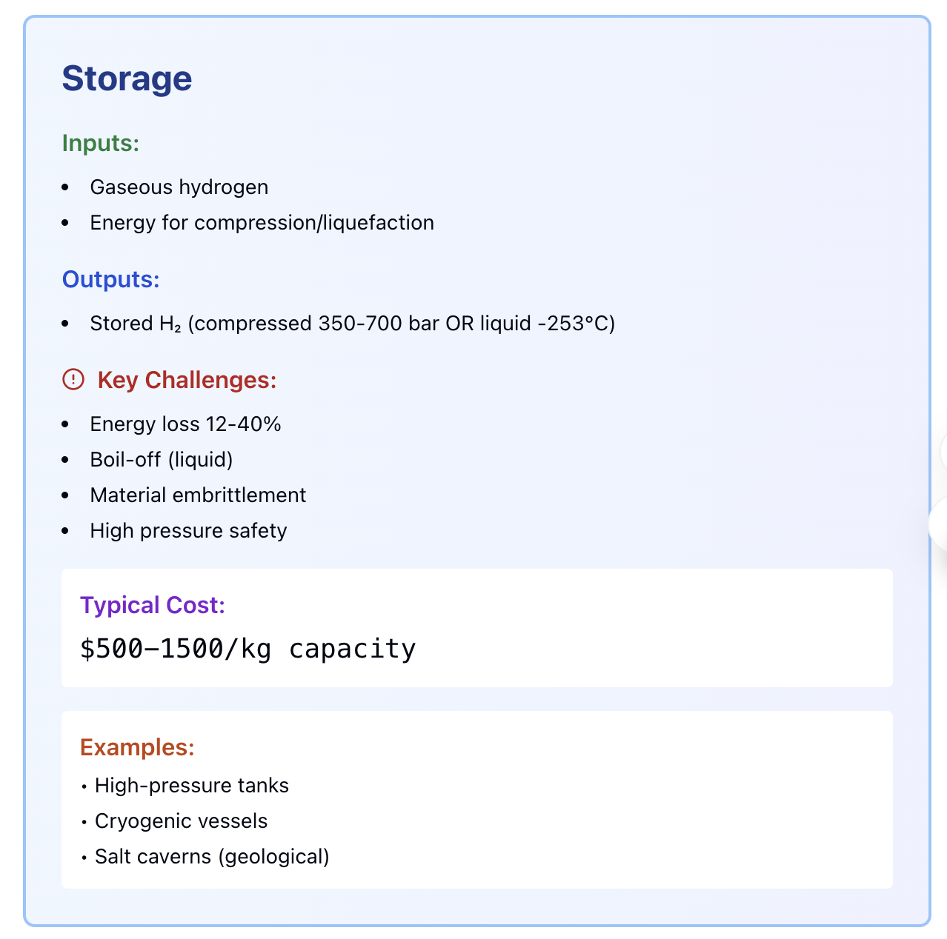
THE SUPPLY CHAIN DILEMMA:
In traditional supply chains, inventory holding cost is ~2-5% of product value- In hydrogen supply chains, storage DESTROYS 12-40% of the energy value

Slide 18
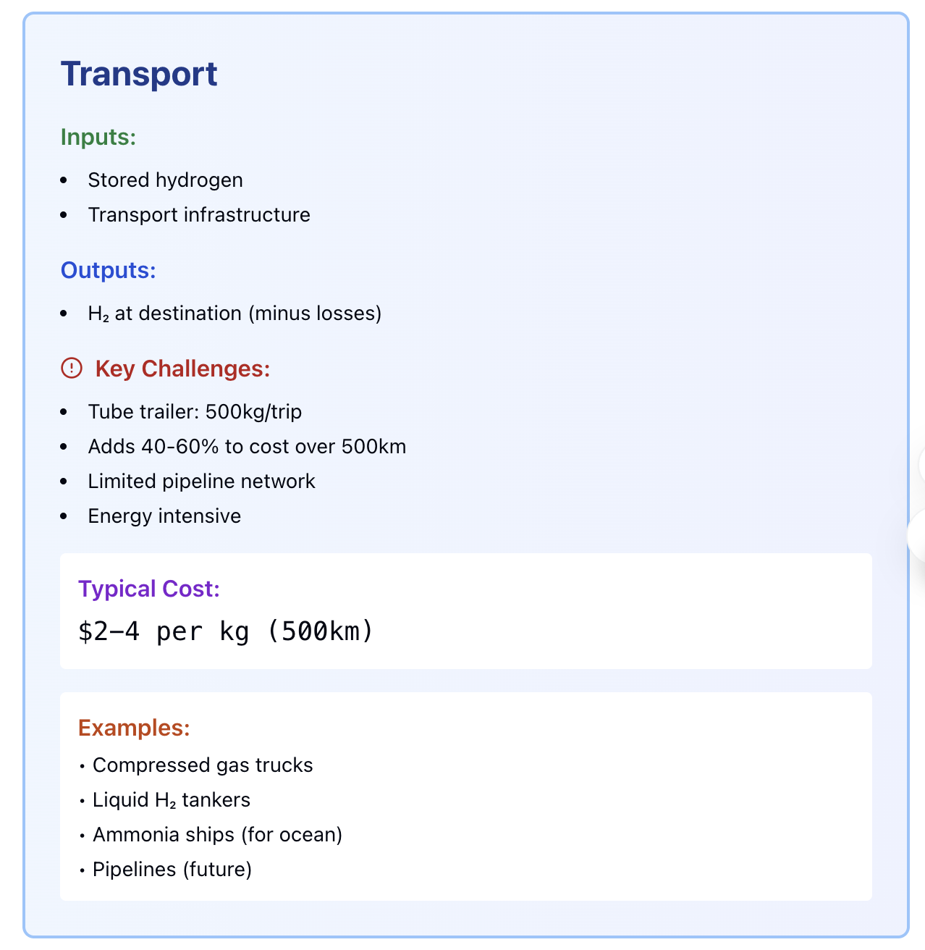
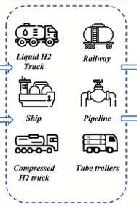
Hydrogen favours LOCAL production near demand, unlike oil which is produced centrally and distributed globally

Slide 19
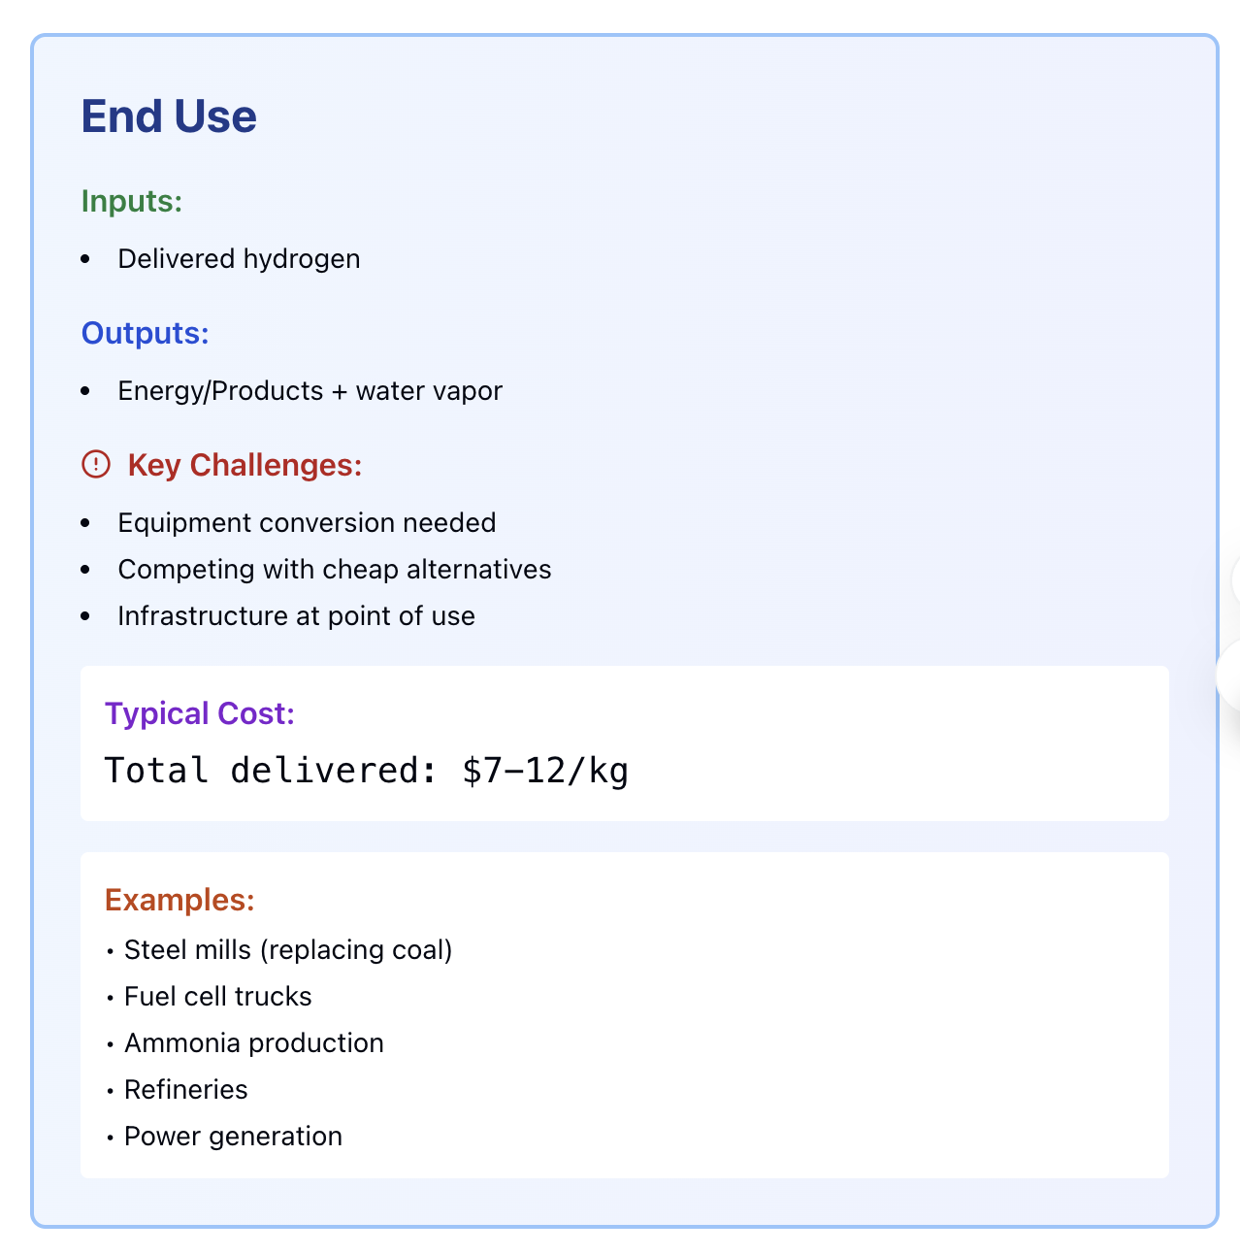
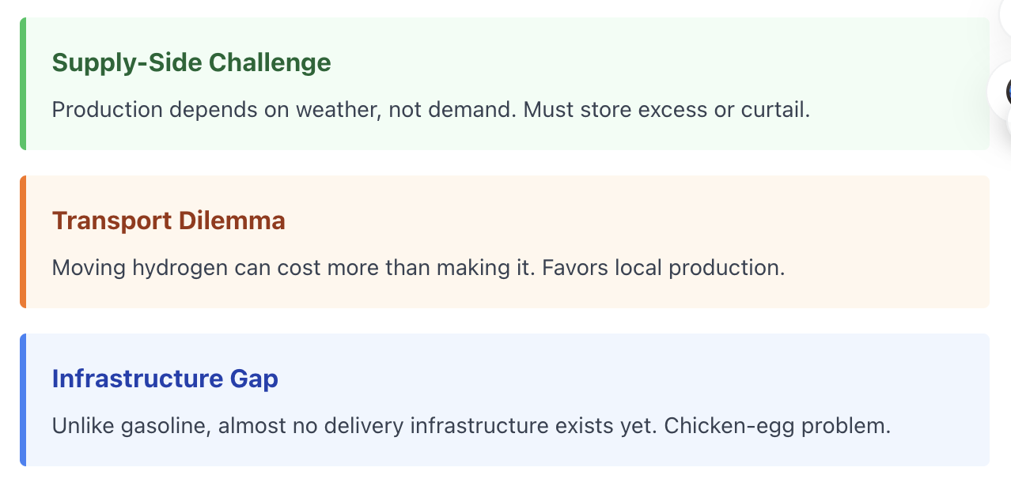
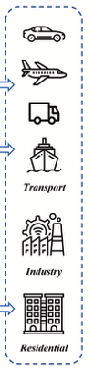

Slide 20
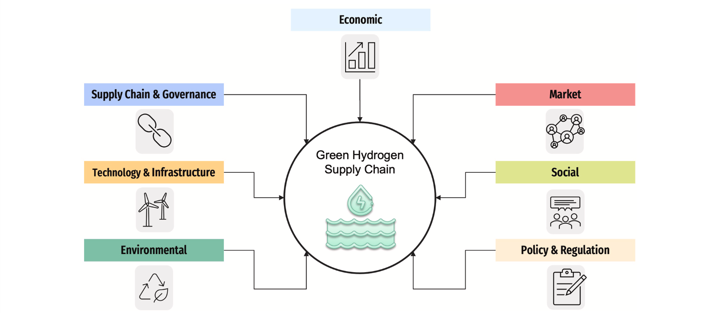
What Shapes a Green Hydrogen Supply Chain?
Azadnia, A. H., McDaid, C., Andwari, A. M., & Hosseini, S. E. (2023). Green hydrogen supply chain risk analysis: A european hard-to-abate sectors perspective. Renewable and Sustainable Energy Reviews, 182, 113371.

Slide 21
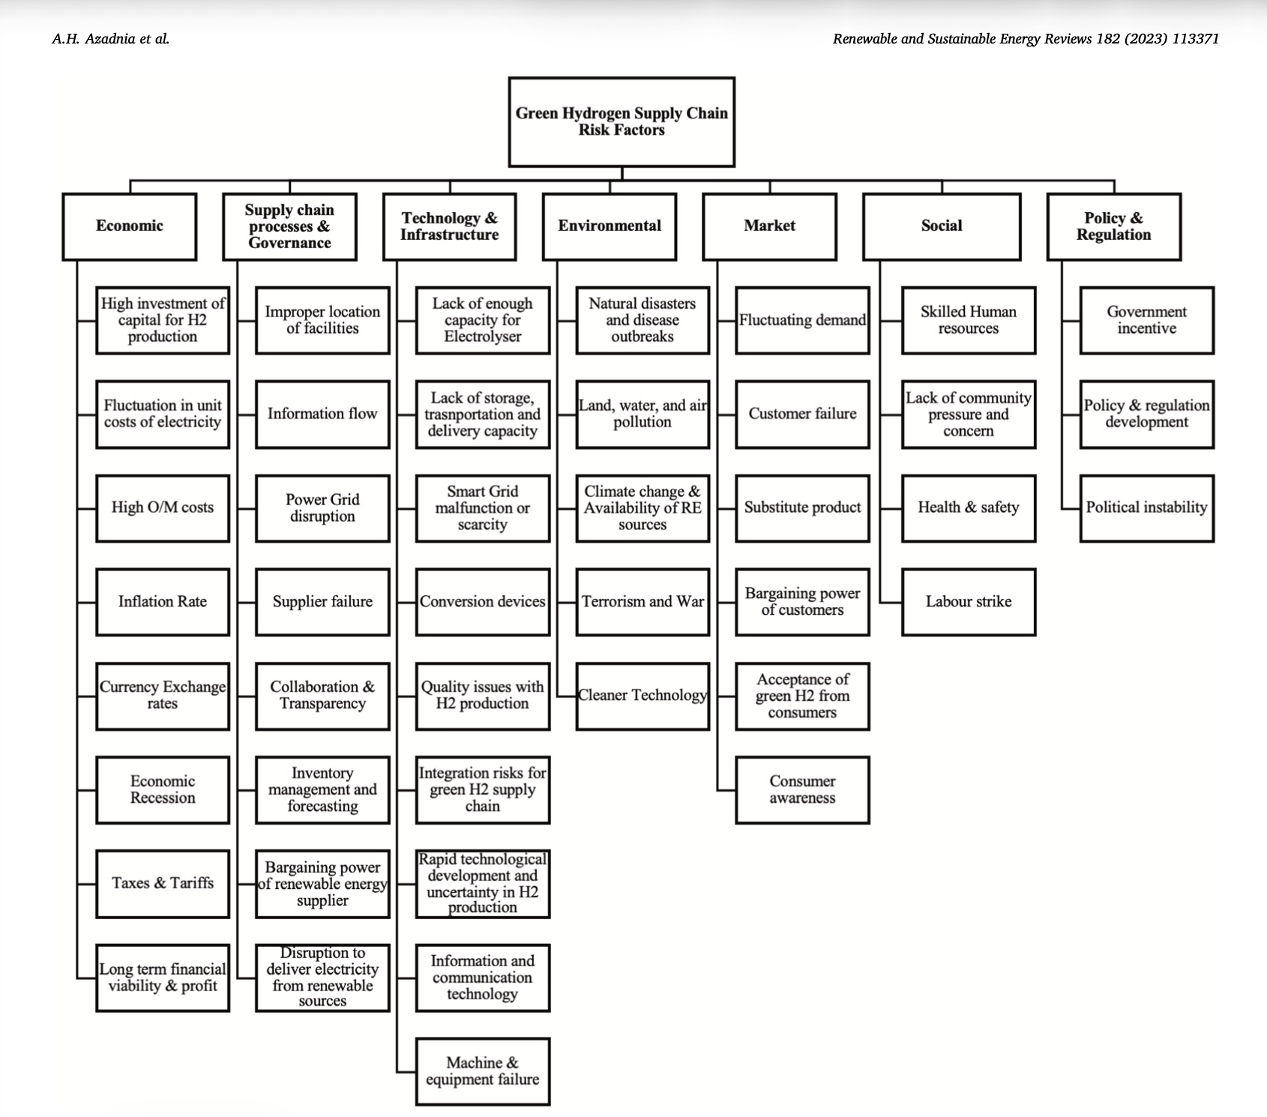
Green Hydrogen Supply Chain Risk Factors
Azadnia, A. H., McDaid, C., Andwari, A. M., & Hosseini, S. E. (2023). Green hydrogen supply chain risk analysis: A European hard-to-abate sectors perspective. Renewable and Sustainable Energy Reviews, 182, 113371.

Slide 22
Hydrogen Chicken-and-Egg Problem
Electrolyzer builder: "We'll build IF there's guaranteed demand"
Industrial users: "We'll commit IF hydrogen is cost-competitive"
Fleet operators: "We'll buy hydrogen trucks IF refuelling infrastructure exists"
Refuelling stations: "We'll build IF there are enough trucks"
Government: "We'll provide subsidies IF all parties commit"
Infrastructure and Market must be built together.
You're not entering a market. You're creating an Ecosystem.
Hydrogen supply chains are system problems. Each stakeholder waits for the others. No one moves first. This is why coordination mechanisms, policy, and risk-sharing are needed.

Slide 23

Opportunity and Challenge
In 2024, global investment in hydrogen infrastructure exceeded $320 billion. By 2030, the hydrogen economy is projected to reach $2.5 trillion annually.
Question
How do you build a multi-trillion dollar supply chain when the infrastructure doesn't exist, the customers aren't ready, and the product costs 3-5 times more than alternatives?
23
23

Slide 24
Why This Matters to You
This is too niche? Too uncertain? Too far in the future?
Every supply chain innovation comes from constraints!
Just-in-time → From Japan's lack of warehouse space
Containerisation → From ships sitting in port too long
Amazon's network → From customers wanting things faster
Green Hydrogen constraints?
Intermittent supply
Product that doesn't want to be stored
No existing infrastructure
Must be cost-competitive with cheap alternatives

Slide 25
A Prototype for thinking about supply chains in an era of technological transformation
If green hydrogen supply chains require us to rethink inventory, transportation, forecasting, and network design... what OTHER products or technologies on the horizon might similarly disrupt our assumptions?
Cultured meat (living cells in transit)?
Quantum computers (extreme temperature control)?
Carbon capture CO2 (negative-value 'waste' that must be moved)?
Personalised pharmaceuticals (batch size of one)?

Slide 26
The Invitation
Over the next decade, companies will spend billions building this supply chain.
They need people who can:
Plan with uncertainty because forecasting in emerging sectors is nothing like forecasting in stable ones.
Design networks from scratch not optimising existing routes, but imagining what the network could be.
Make trade-offs between competing objectives cost vs. carbon, efficiency vs. resilience, short-term vs. long-term.
Think in systems, not silos because hydrogen doesn’t work unless the entire ecosystem works.
The most exciting supply chains aren't the optimised ones.
They're the impossible ones that someone figures out how to make work.

Slide 27

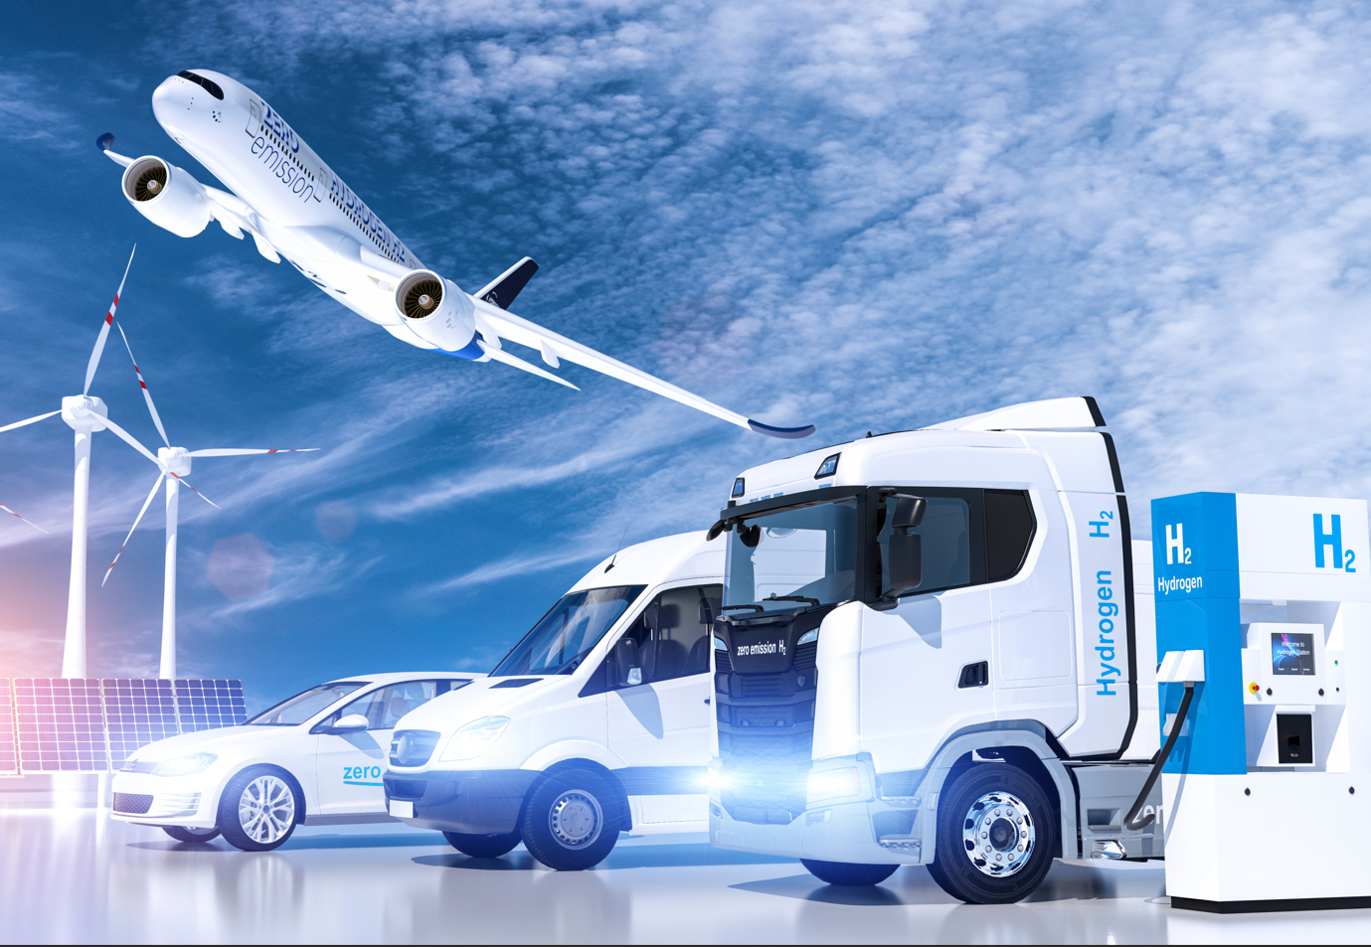
Thank you
Find Airport Decarbonising Report here

Slide 28
References
Azadnia, A.H., McDaid, C., Andwari, A.M. and Hosseini, S.E. (2023) Green hydrogen supply chain risk analysis: A European hard-to-abate sectors perspective. Renewable and Sustainable Energy Reviews, 182, 113371.
Hydrogen Council (2023) Hydrogen Insights 2023. Brussels: Hydrogen Council. Available at: https://hydrogencouncil.com/en/hydrogen-insights-2023/
International Energy Agency (2023) Global Hydrogen Review 2023. Paris: IEA. Available at: https://www.iea.org/reports/global-hydrogen-review-2023
IEA (2023) Net Zero by 2050: A Roadmap for the Global Energy Sector – 2023 Update. International Energy Agency. Available at: https://www.iea.org/reports/net-zero-by-2050
Sgarbossa, F., Arena, S., Tang, O. and Peron, M. (2023) Renewable hydrogen supply chains: A planning matrix and an agenda for future research. International Journal of Production Economics, 255, 108674.
UNFCCC (2024) Climate Action Portal. Available at: https://climateaction.unfccc.int/ (Accessed: 24 November 2024).

